Slide 1
Building Object Systems
Features, Tradeoffs, and Pitfalls

Slide 2
Introduction
Cellphones
Who am I?
  Alex Duran
  aduran@ionstorm.com
  Programmer
  Object System for Deus Ex 2 and Thief 3

Slide 3
Outline
Purpose and Scope of Talk
Brief Definition of Terms
Static Hierarchy Based Systems – Brief Discussion
Component Based Systems - Decisions and Consequences
Summary

Slide 4
Purpose of Talk
Hard to correctly plan for everything, even with experience.
Deus Ex 2 / Thief 3 system designed with knowledge from a previous system in mind.
I still made mistakes.
Know about the options.
Understand the dangers.

Slide 5
Scope of Talk
My experience is single player games.
And large (20+ total team size) development teams.
Not very familiar with:
  Network communication for Object Systems
  Persistent Worlds (Massively Multiplayer).
  Differences for really small teams.

Slide 6
What do I mean by these?
I expect most of you define these the way I do, but let’s be clear:
Object System
Hierarchy
Component / Property
Archetype
Instance
Designer

Slide 7
What do I mean by…
…Object System?
System responsible for maintaining data about Objects and Attributes.
Clients of the system can do queries about the value of an Attribute on an Object.
Answers the question: What is the value of “Health” on a “MedBot”?

Slide 8
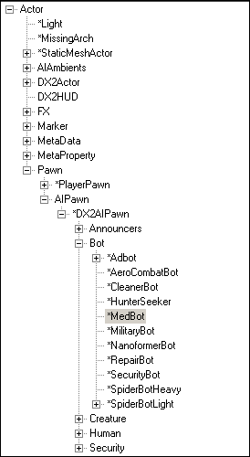
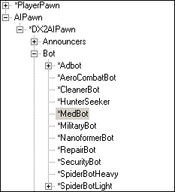
...Hierarchy?

Slide 9

…Component/Property

Slide 10
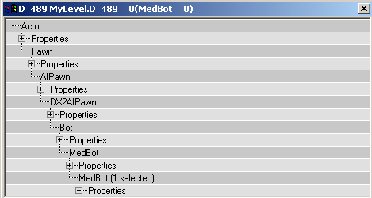
…Archetype and Instance?

Slide 11
…Designer?
Edits data on Archetypes or Instances.
Data editing doesn’t cause a recompile and doesn’t require a programmer.
Generally not a programmer, so doesn’t know how code works underneath.

Slide 12
Static Hierarchies
Standard C++ model of inheritance.
Components are required – every child of has all the components of the parent(and maybe more).
Memory / Complexity are issues, nobody wants to put all functionality on the base archetype.
Since the layout is static and known –code can be faster, data apparent to programmers (no extraneous data).

Slide 13
Static Hierarchies - Mistake
Ultima Underworld 1 – First Person RPG, fairly complex game.
Assumed: NPCs and Doors don’t need to share many components.
Later in design, player needed to have conversation with a door… but only NPCs have the conversation component.
Can’t push component up now, must hack around problem.

Slide 14
Static Hierarchies - Success
Halo 1 – Much simpler in terms of objects.
Design fairly well understood.
Needed a fast, simple object system.
Can safely make NPCs and Doors separate.
Still had minor issues – NPC archetypes not subdivided enough.
Halo 2 – even better understood.

Slide 15
Dynamic Hierarchies
aka Component-Based hierarchies.
Data determines:
    Hierarchy Organization
    Kinds and values of data on Archetypes
    …and on Instances

Slide 16
Static/Dynamic Hybrid
Static hierarchies improve speed.
Dynamic hierarchies improve flexibility.
Can have a hierarchy with some static branching at top, dynamic below that.
Be careful… can still make mistakes.
Deus Ex 2 – Emitters, characters, everything else.

Slide 17
On to the new…
I expect most people in this room already were familiar with most of what I just talked about.
If not, see Scott Bilas’s talk from last year’s GDC.
Doug Church also did a useful talk recently.
Now that we’re on the same page…

Slide 18
Component Based Systems - Decisions and Consequences
Next:
  Inheritance – Basic
Later:
  Component-Centric vs. Object-Centric
  Components – Simple vs. Complex
  Inter-Component Interactions
  Inheritance – Advanced

Slide 19
Inheritance – What I Mean
Components are optional… objects don’t have to have them.
If an archetype has values for a component, must the instance?
Store values on instances (or child archetypes) when distinction from parent value is desired (when a medbot takes damage, start storing hitpoints)

Slide 20
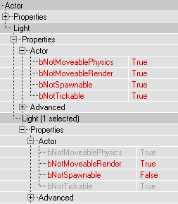
Inheritance - Example

Slide 21
Inheritance – Benefits
Removes problem of storing redundant data.
This saves memory.
Often more importantly, this helps designers. If they have to maintain the same data in multiple places… it will get out of sync.

Slide 22
Inheritance - Cost
If an object doesn’t have a component, must ask parent.
If parent doesn’t have it… must ask parent’s parent… etc.
Depth of five or more not uncommon (average depth traversal for failure in Deus Ex 2 is ~3.6)
There are strategies to deal with these problems… I’ll get to them later.

Slide 23
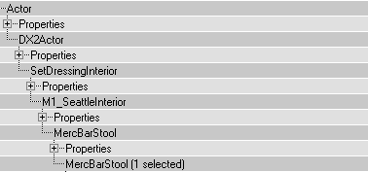
Inheritance –
Failed Health Query

Slide 24
Component Based Systems -Decisions and Consequences
Done:
  Inheritance - Basic
Next:
  Component-Centric vs. Object-Centric
Later:
  Components – Simple vs. Complex
  Inter-Component Interactions
  Inheritance – Advanced

Slide 25
Component-Centric vs. Object-Centric
What is Object-Centric?
What is Component-Centric?
Why one or the other?

Slide 26
What is Object-Centric?
Object-Centric is the way people usually conceptually think of systems.
System thinks of its data as a collection of Objects, each of which has its own Components.
Data “belongs” to objects.
Object-Centric is the way data is presented to designers… every image so far has been “Object-Centric”.

Slide 27
What is Component-Centric?
Objects are just UIDs(unique identifiers). They’re identical.
Components store UID-data pairs.
The behavior of an object is determined by the data that components store for that UID.
Internal only – externally data is displayed as if it were object-centric.
Thief 1, Thief 2 worked this way.

Slide 28
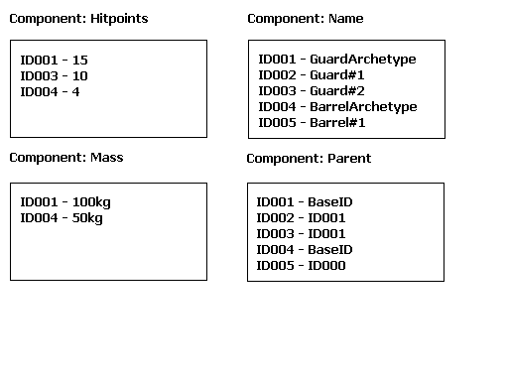
Component-Centric: Diagram

Slide 29
Why Be Object-Centric?
Intuitive. Internal representation matches the way people think about the data.
Easier to extract/insert an object from the world. (Streamed Worlds, maybe)
Objects can have associated code. Good for static-dynamic hybrid hierarchy systems (Like Deus Ex 2)
Can scope components.

Slide 30
Why Be Component-Centric?
Efficiency – Each component stores its own data… can optimize for:
  Sparse vs. Dense (HackStrength vs. Mass)
  Random Access vs. Iterated (Hitpoints vs. Physics)
Helps enforce data-driven aspect of game… objects can’t be anything but data.

Slide 31
Component Based Systems - Decisions and Consequences
Done:
  Inheritance – Basic
  Component-Centric vs. Object-Centric
Next:
  Components – Simple vs. Complex
Later:
  Inter-Component Interactions
  Inheritance – Advanced

Slide 32
Components –
Simple vs. Complex
Simple Components (Hitpoints, Mass, Friction, Elasticity)
Complex Components (DamageModel, PhysicsModel)
Complex also “Aggregate” or “Bundled” components.

Slide 33
Simple Components – Pros/Cons
Lightweight – low memory cost to setting data(just add Hitpoints)
Easy inheritance.
More allocations, more overhead to tracking. (Deus Ex 2: >50% spent on tracking. Most components are simple.)
Be careful not to split functionality up too much. (Deus Ex 2 Inventory)

Slide 34
Complex Components – Pros/Cons
Keep relevant data together(Physics vs. Mass,Friction,Elasticity)
Less overhead on tracking whether objects have particular components.
Sub-component inheritance/override becomes important (inherit just Friction).
Heavyweight allocation(Suppose you only need Elasticity?)

Slide 35
Too Simple?
Deus Ex 2 Inventory
Four different components:
Inventory Type (essential)
User Arm Animation Set (essential)
Inventory Icon (important)
Inventory Sound Effects (important)
Could get around with inter-component requirements, but that adds overhead (and we don’t have that feature)

Slide 36
Too Complex?
Dungeon Siege - Inventory
9000 lines of code. One component.
Not all of that necessary.
Tendency for component to have everything except the kitchen sink.

Slide 37
Component Based Systems - Decisions and Consequences
Done:
  Inheritance – Basic
  Component-Centric vs. Object-Centric
  Components – Simple vs. Complex
Next:
  Inter-Component Interactions
Later:
  Inheritance – Advanced

Slide 38
Inter-Component Interactions : Requiring
Some components only make sense when other components exist (RenderScale without RenderMesh)
You’d like to have some components require other components.
Simple components – more important.
Deus Ex 2 doesn’t have a built-in system for this, so we have to rely on warnings or forcefully setting default values.

Slide 39
Inter-Component Interactions : Excluding
On the other hand, some components don’t make sense with each other (RenderMesh and RenderSprite).
To know which to use, you need another component (RenderType)
Being able to make some component exclusive(or mutually exclusive) would change this.
SetProperty generally ok to have logic, since infrequent in-game.

Slide 40
Component Based Systems - Decisions and Consequences
Done:
  Inheritance – Basic
  Component-Centric vs. Object-Centric
  Components – Simple vs. Complex
  Inter-Component Interactions
Next:
  Inheritance – Advanced

Slide 41
Inheritance - Advanced
Optimization Strategies
  Caching
  Instantiation
  Tree Flattening
Dynamic Archetypes
  Changing the values on Archetypes
  Changing the Archetypes for an Instance
Multiple Inheritance
Inheritance Blocking

Slide 42
Inheritance Optimization - Caching
Every time a query fails you go up the tree a level… and do another lookup.
Failures go all the way up.
Cache the results of queries in the hierarchy.
Make sure to cache failures as well as successes… since failures are more expensive.
Good statistics can inform caching (cache Physics, not HackStrength)

Slide 43
Inheritance Optimization –
Cache Invalidation
Does it matter?
Most systems don’t support changing data on archetypes while running the game (where speed matters most).
If you can’t affect the results of an up-tree query in game, you can’t invalidate the cache.

Slide 44
Inheritance Optimization - Instantiation
Similar to caching, but not on-the-fly.
Mark components as “instantiated”, meaning that their values get copied down to instances automatically.
Better for things where instances are likely to differ from archetypes anyway (TimeSinceRendered).
No need to cache failures… implied.
Same potential for cache invalidation.

Slide 45
Inheritance Optimization –
Instantiation Dangers
Can do this in editor, or as part of “compiling” levels.
If you do on data used in editor, get invalidation problem for sure, since archetypes change in the editor.
Example: Thief 1 – Physics component, always forcing global replace on instances, invalidating some special objects(Key “hanging” on board)

Slide 46
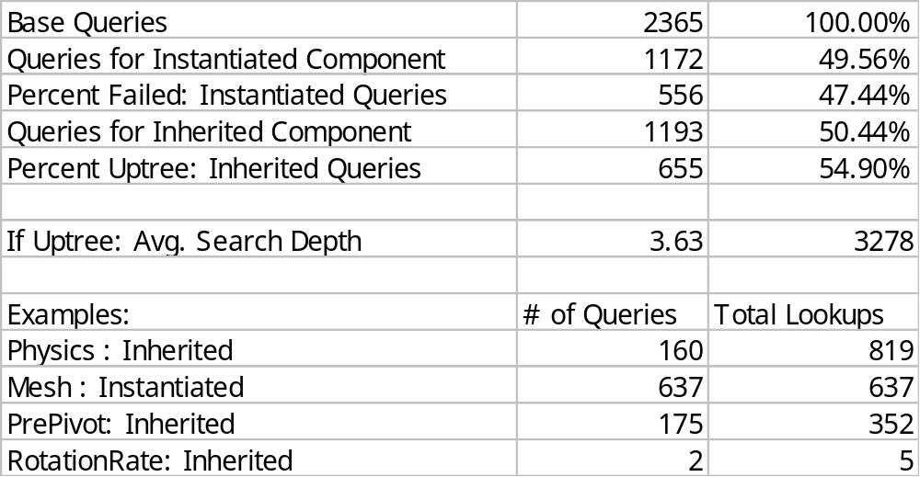
Query Statistics – Deus Ex 2

Slide 47
Inheritance Optimization – Tree Flattening
Can also reduce inheritance cost by flattening the hierarchy as a “compile” step on data before running the game.
Dungeon Siege does this.
Like instantiation, but stops at archetypes, not instances.
Loses inheritance benefit of memory savings.
Prevents changing archetypes.

Slide 48
Dynamic Archetypes –
Changing Values
Single Player Games - Just change existing instances manually.
But… Massively Multiplayer Persistent World?
  Prefer instances to match archetypes.
  Don’t want to shut down.
  Just change the archetype…

Slide 49
Dynamic Archetypes –
Getting a Different Archetype
What about changing which archetype is my parent?
I can see uses… but none of them seem worth it in a single inheritance system. Just copy the relevant data over to a new instance.
But worth thinking about?
There are use cases under a multiple inheritance model…

Slide 50
Multiple Inheritance
Data rather than code…
Multiple code inheritance seems destined to confuse people, especially designers who can’t see the code.
Not so for data, if:
  Very simple rules for order of inheritance
  Results of rules apparent to designers
Example: Thief 1 Metaproperties

Slide 51
Multiple Inheritance –
Thief 1 Metaproperties
Metaproperties are just archetypes with data associated with various component settings. Values set by designers.
Many were vulnerabilities. Every wooden object inherited from WoodVulnerability in addition to normal inheritance.
Also used to affect NPC behaviors (example on next slide)

Slide 52
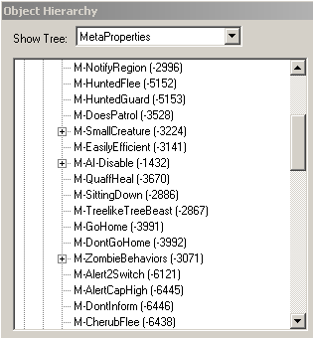
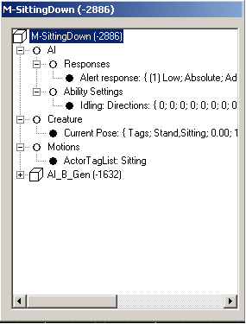
Metaproperty Example

Slide 53
Multiple Inheritance –
Thief 1 Metaproperties
Metaproperties could be changed in game.
Since this meant that an instance’s archetype could change, it affect caching and other assumptions.
But easy way for designers to control behavior.
Set all data for a guard to fall asleep (anim, barks…) by adding appropriate Metaproperty.

Slide 54
Inheritance Blocking
What if parent archetype has component, like DamageModel, but this archetype doesn’t want it.
Could just recreate data elsewhere, but then you’ve got data duplication issues.
If there were a way to specifically NOT inherit a component, then you can put it where you want it, and just block the inheritance.

Slide 55
Summary
Brief summary of the talk
Acknowledgments
Q&A

Slide 56
Static Hierarchies vs. Dynamic Hierarchies
Component-based hierarchies provide flexibility for future design decisions.
Static hierarchies provide speed.

Slide 57
Component-Centric vs. Object-Centric
Component-Centric systems provide efficiency when managing existing objects.
Object-Centric systems provide simplicity and easier addition and removal of objects.

Slide 58
Simple Components vs. Complex Components
Simple components support inheritance more easily, at the cost of tracking overhead and additional inter-component dependencies.
Complex components encapsulate entire concepts better, but proper inheritance requires sub-component inheritance.

Slide 59
Inheritance
Inheritance prevents duplication of data, making it easier for designers to keep objects up to date.
Can be slow. A number of optimization tricks exist, but reduce options for changing archetypes.
Changing archetypes is often not useful, but can work for you in MMORPGs or with multiple inheritance.

Slide 60
What I Didn’t Talk About
Massively Multiplayer Games (except in Dynamic Archetypes)
Networking… communicating value changes.
Effects of system on end users trying to build content with provided tools.
References between objects.

Slide 61
Acknowledgements
For talking about their systems:
  Scott Bilas (Dungeon Siege)
  Chris Butcher (Halo)
  Steve Jakab (Star Wars Galaxies)
For additional insight into Thief 1 system:
  Doug Church, Randy Smith, Chris Carollo

Slide 62
Other Talks (from last year)
GDC 2002 : Scott Bilas :
  "A Data-Driven Game Object System"
  http://www.drizzle.com/~scottb/gdc/
GDC 2002 : Rob Fermier :
  Creating a Data Driven Engine: Case Study: The Age Of Mythology
  http://www.gdconf.com/archives/2002/index.htm
And more recently…

Slide 63
Other Talks (this year)
GDC 2003 : Jeremy Chatelaine
  “Enabling Data Driven Design Tuning via Existing Tools”
  www.kamron.net
Non-GDC : Doug Church :
  “Object Systems : Methods for attaching data to objects, and connecting behaviors.
  http://www.d6.com/users/checker/ObjSys.ppt

Slide 64
Q&A
Fill out your evaluations.
Any questions?
If I don’t have time to answer your question during Q&A, I’ll be around to talk afterwards.
After GDC, you’ll be able to find the slides for this talk at:
  http://www.ionstorm.com/GDC2003/AlexDuran/
And I can be reached at:
  aduran@ionstorm.com

